Slide 1
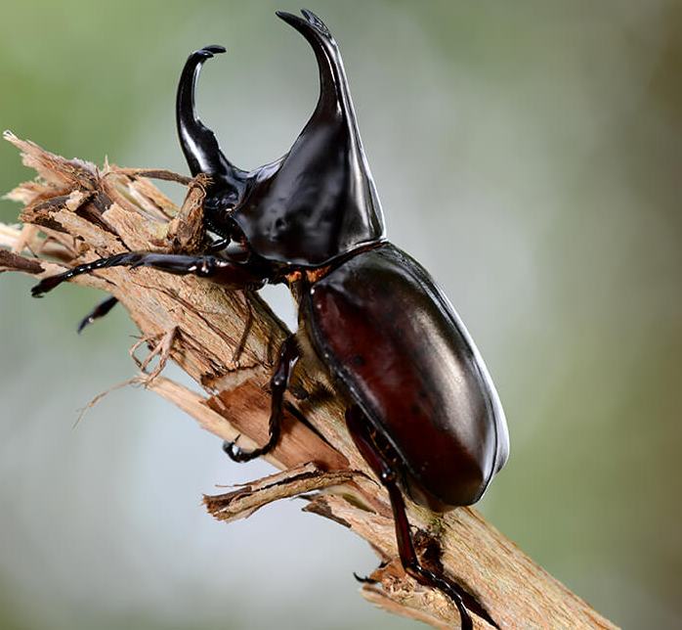
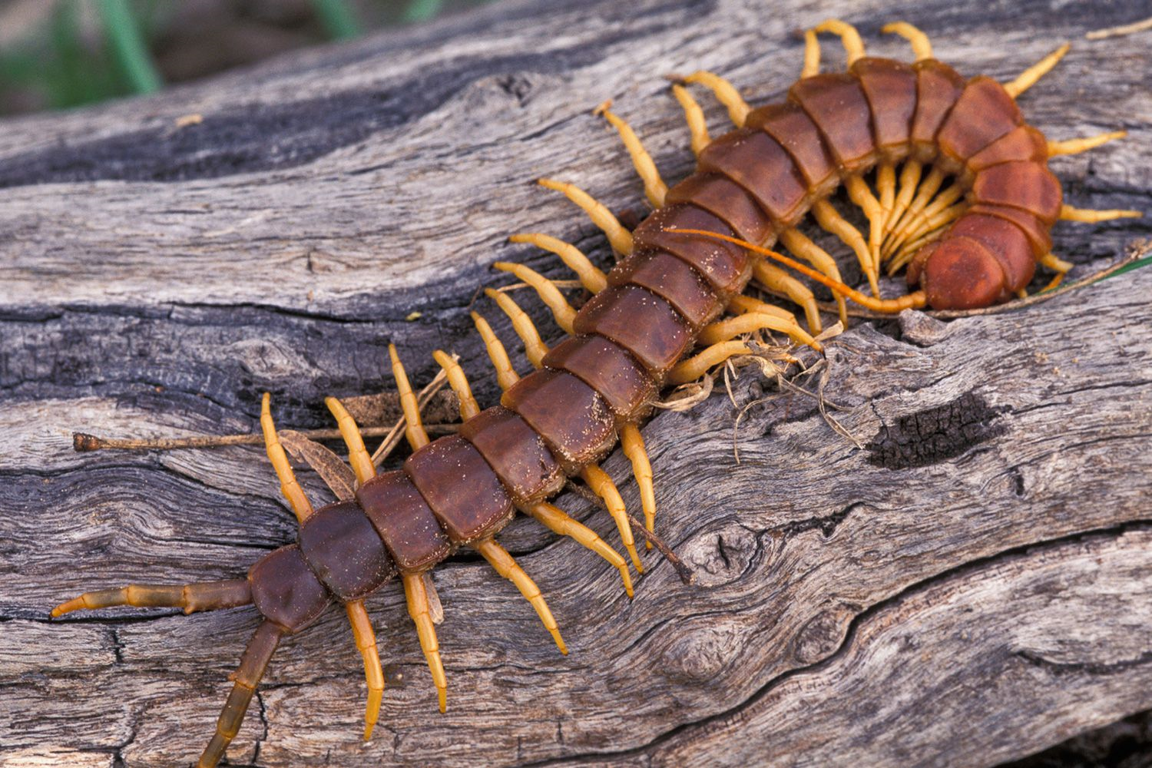
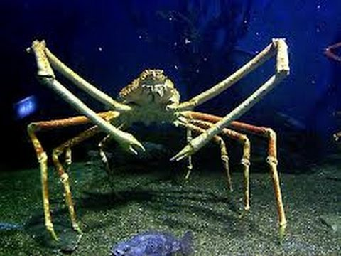
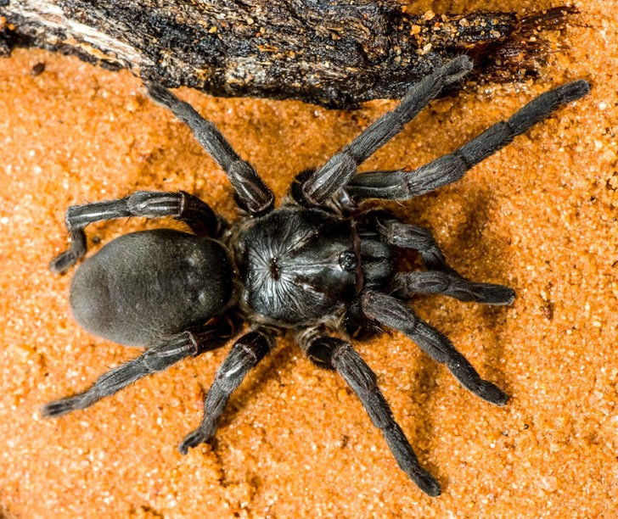
Daily Review
Arthropods
Animals in the Arthropoda phylum have jointed legs, exoskeletons, and segmented bodies.
Arthropods can be grouped into 4 classes:
Insecta – 3 pairs of legs and 3 body segments
Arachnida – 4 pairs of legs and 2 segments
Crustacea – 5 or more pairs of legs and 2 or 3 segments
Myriapoda – many pairs of legs and a worm-like body
State the class of the arthropod shown and give a reason for each choice.
Vocabulary
ex·o·ske·le·ton (noun) a hard outer body covering seg·men·ted (adjective) made up of different segments (parts or sections)

Slide 2
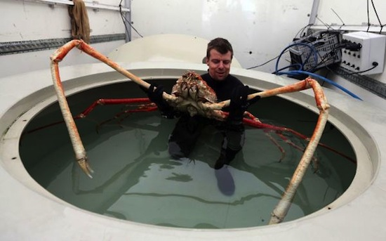
Daily Review
Fun fact: the Japanese spider crab has the largest leg span of any arthropod (up to 5.5 m from claw to claw)!

Slide 3
Seven Other Phyla Year 7 Science

Slide 4
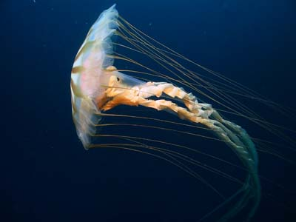
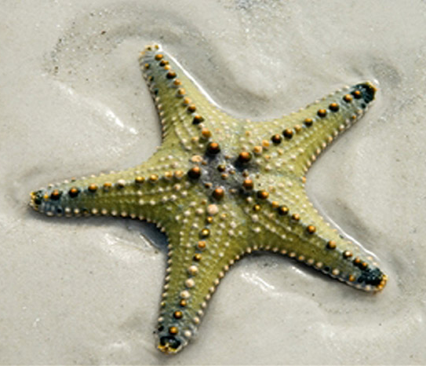
Learning Objectives
CFU
How many lesser known phyla are we naming and describing today?
Name and describe the characteristics of seven lesser known phyla.
Organise this information into a useful form.
Activate Prior Knowledge
Starfish and jellyfish both have ‘fish’ in their name, but neither one is actually a fish. What characteristics would these animals need to be classified as fish?

Slide 5
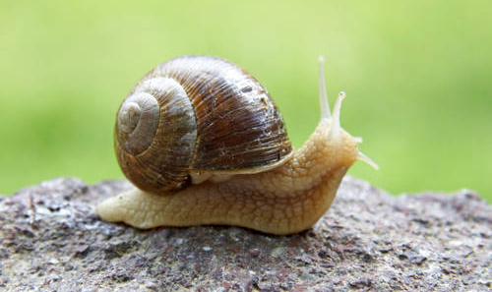
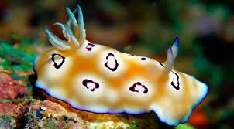
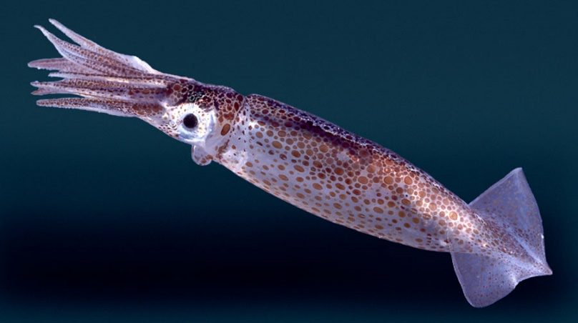
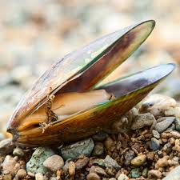
Concept Development
CFU 1
Why are all of these animals in the Mollusca phylum?
Mollusca
Molluscs have soft bodies and often have a protective shell.
CFU 2
Jaiveer says that turtles are molluscs, since they have a protective shell. Is he correct? Why or why not?
Snail
Nudibranch
Mussel
Squid
Notes:
Mention at this point that we’ll take notes later, not as we go

Slide 6
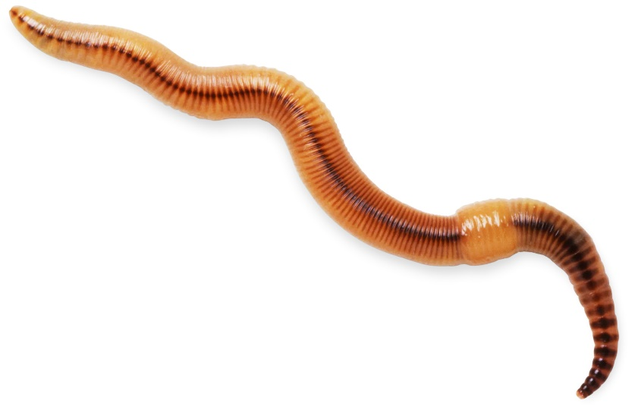
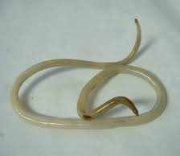
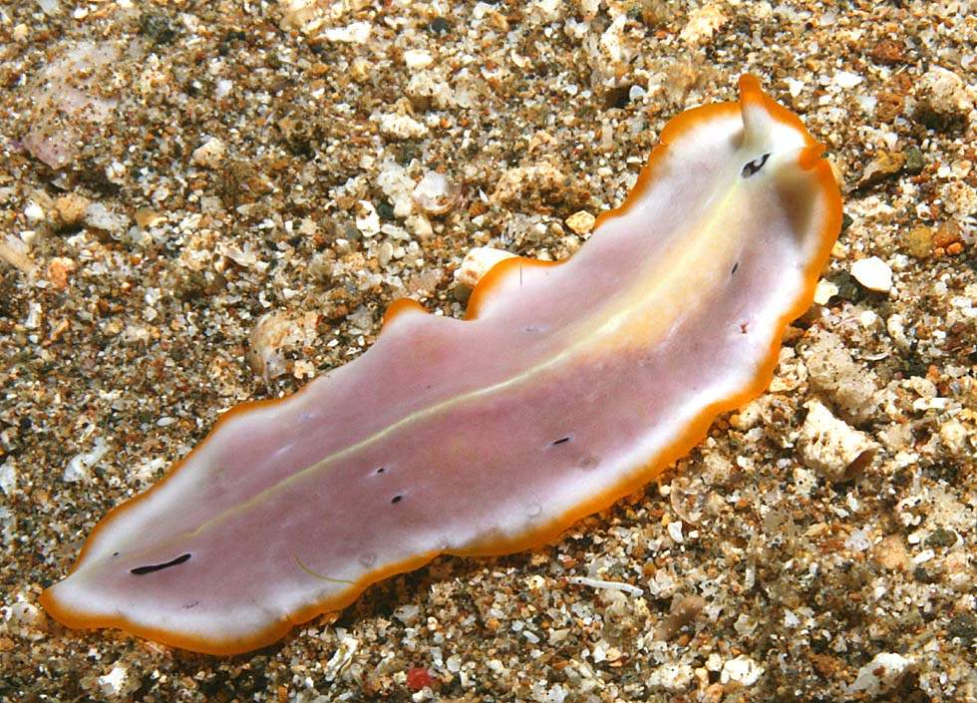
Concept Development
CFU 1
What is the difference between nematodes and platyhelminths?
Worms (Nematoda, Platyhelminthes, Annelida)
There are three phyla of worms:
Nematodes – worms with a long, round body
Platyhelminths – worms with a flat or leaf-like body
Annelids – worms with a segmented body
CFU 2
What is the difference between annelids and nematodes?
CFU 3
Which phylum does each of these animals belong to? Explain your choice.
Earthworm
Ascaris
Turbellarium

Slide 7
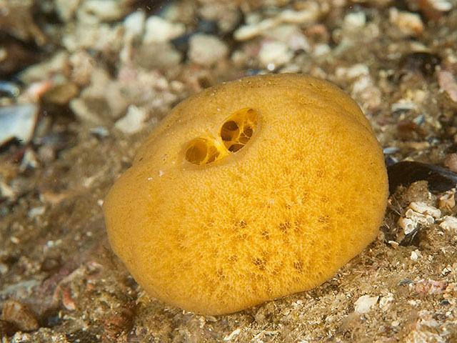
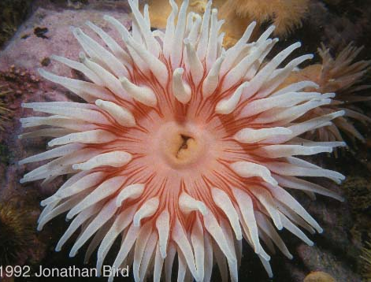
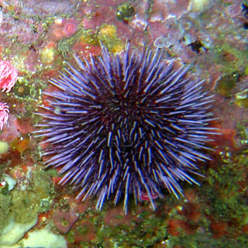
Concept Development
CFU 1
Which phylum contains animals with stinging tentacles?
Aquatic Phyla (Porifera, Cnidaria, Echinodermata)
There are 3 phyla that are water-based:
Sponges – spongy body with holes
Cnidarians – soft, hollow body and stinging tentacles
Echinoderms – have rough, spiny skin and repeated body parts around a central body
CFU 2
Why are starfish classified as echinoderms?
Sea sponge
Sea Urchin
Jellyfish
Starfish
Sea Anemone

Slide 8
Skill Development / Guided Practice
CFU 1
Which words do you need to write down?
We are now going to organise this information and turn it into useful notes.
Get a graphic organiser from your teacher or from Connect.
We are going to go back through the descriptions of each class. You need to write down the bold words in your graphic organiser.

Slide 9
Skill Development / Guided Practice
Mollusca
Molluscs have soft bodies and often have a protective shell.
Snail
Nudibranch
Mussel
Squid

Slide 10
Skill Development / Guided Practice
Worms (Nematoda, Platyhelminthes, Annelida)
There are three phyla of worms:
Nematodes – worms with long, round bodies
Platyhelminths – worms with flat or leaf-like bodies
Annelids – worms with segmented bodies
Earthworm
Ascaris
Turbellarium

Slide 11
Skill Development / Guided Practice
Aquatic Phyla (Porifera, Cnidaria, Echinodermata)
There are 3 phyla that are water-based:
Sponges – spongy body with holes
Cnidarians – soft, hollow body and stinging tentacles
Echinoderms – have rough, spiny skin and repeated body parts around a central body
Sea sponge
Sea Urchin
Jellyfish
Starfish
Sea Anemone

Slide 12
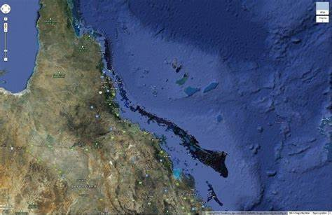
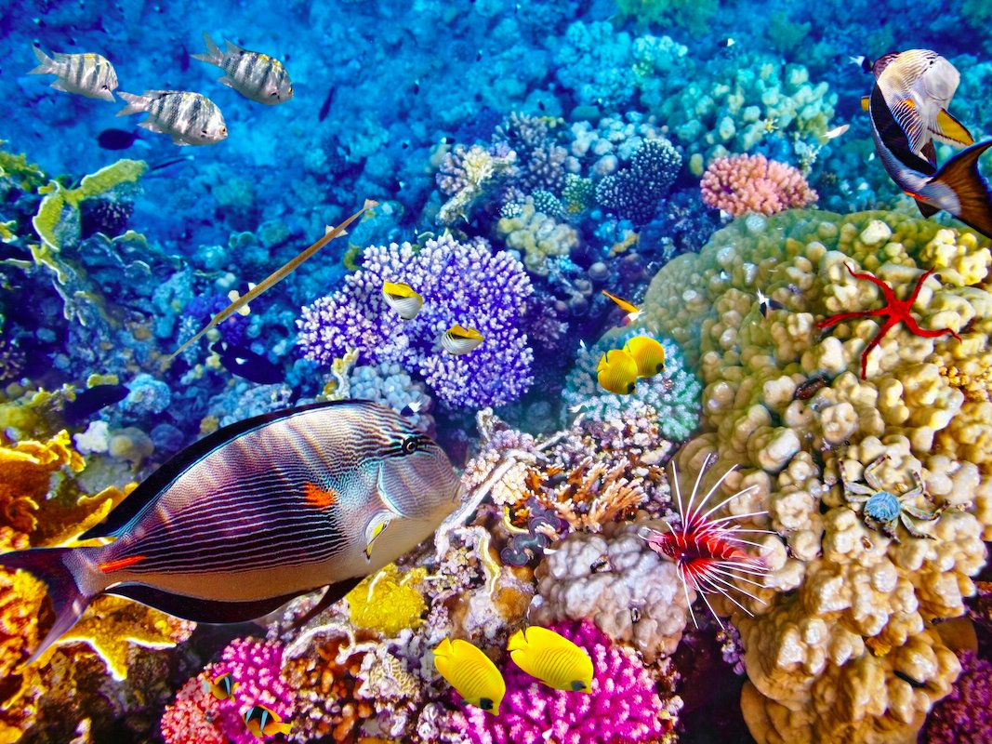
Relevance
The smaller phyla of organisms in the Animal Kingdom play important roles within ecosystems and for humans.
Some Annelids are decomposers and help break down waste and dead material
Many Molluscs are used as food sources for humans and other animals
Coral reefs are very biodiverse ecosystems and are home to many animals in the marine phyla. The Great Barrier Reef off the Queensland coast is a World Heritage Area, so it is important to protect it for the future.

Slide 13
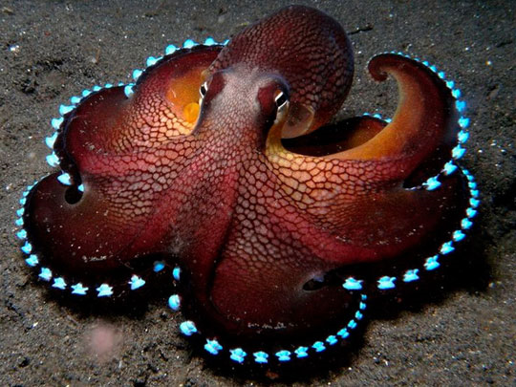
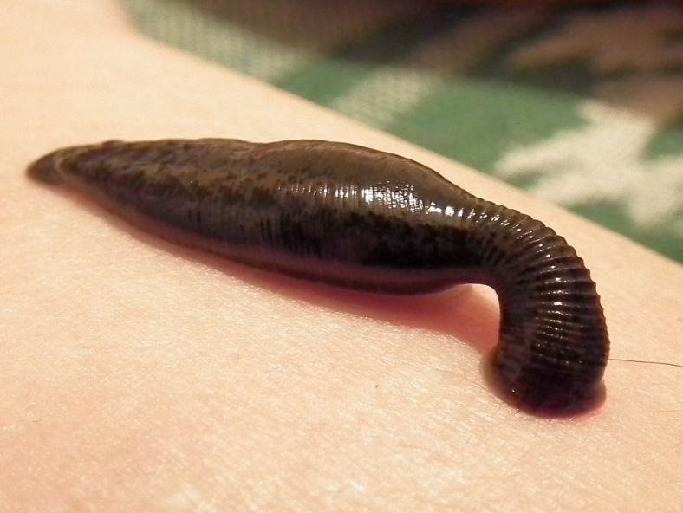
Skill Closure
Using your graphic organiser, answer these questions on your whiteboards:
What are two common characteristics of the Mollusca phylum?
How are the three worm phyla different?
Which phylum does the octopus belong to? Explain your choice.
Which phylum does the leech belong to? Explain your choice.

Slide 14
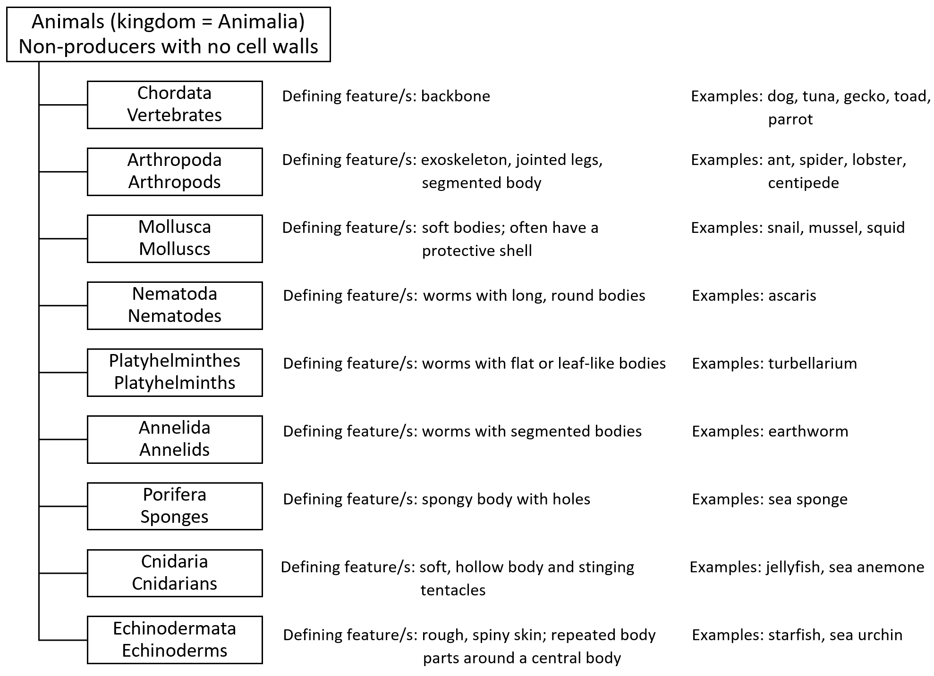
Independent Practice
Complete Questions 1-6 on page 91 of your textbook.

